Slide 1
STOK BİRİM TANIMLARI
https://github.com/ademakkus/
https://www.linkedin.com/in/ademakkus/
https://www.instagram.com/akkusadem19/
https://www.facebook.com/akkusadem19
ADEM AKKUŞ
Bilişim Teknolojileri Öğretmeni

Slide 2
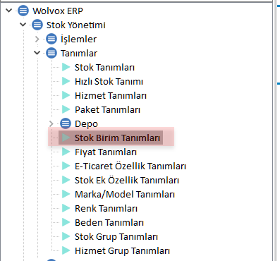
STOK BİRİM tANIMLARI

Slide 3
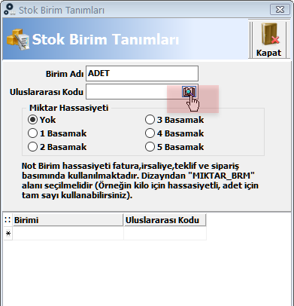
STOK BİRİM tANIMLARI

Slide 4
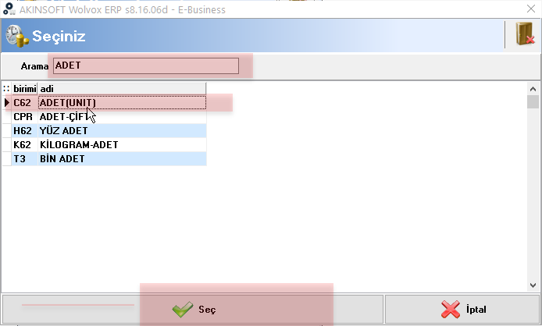
STOK BİRİM tANIMLARI

Slide 5
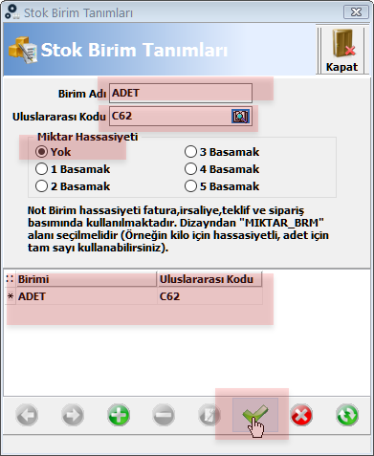
STOK BİRİM tANIMLARI

Slide 6
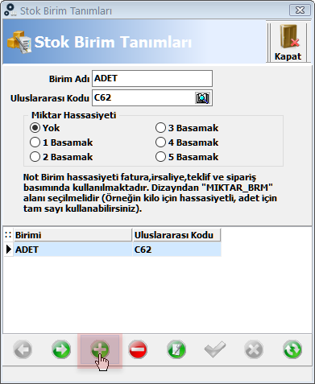
STOK BİRİM tANIMLARI

Slide 7
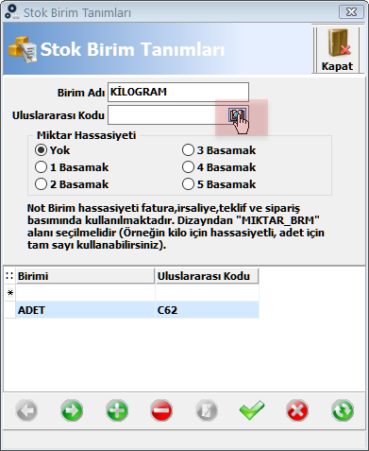
STOK BİRİM tANIMLARI

Slide 8
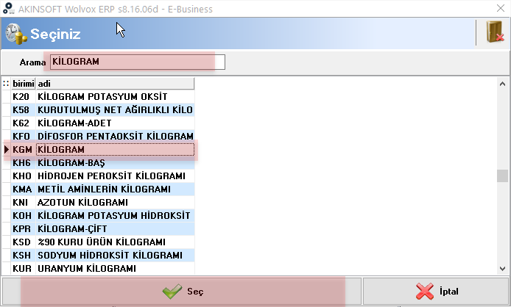
STOK BİRİM tANIMLARI

Slide 9
STOK BİRİM tANIMLARI

Slide 10
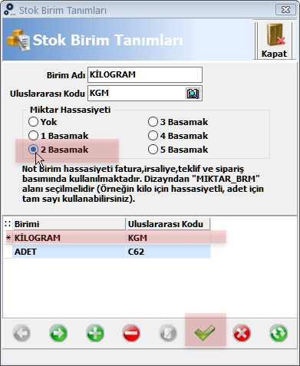
STOK BİRİM tANIMLARI

Slide 11
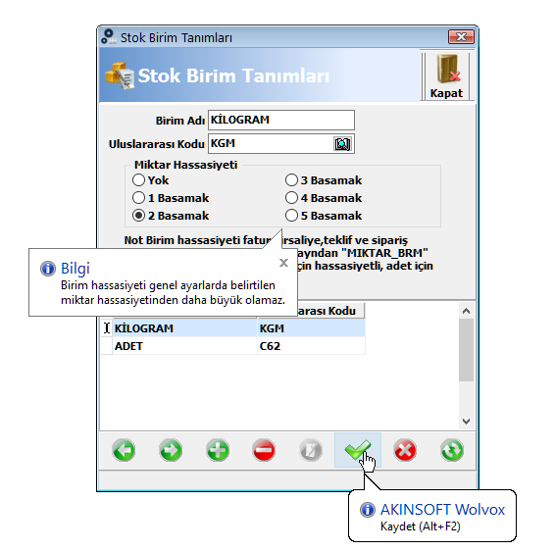
ASORTİ SİSTEMİ

Slide 12
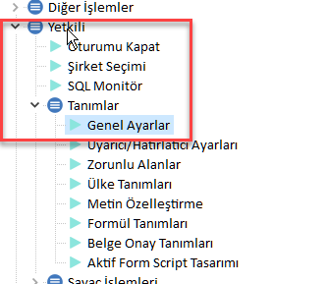
STOK BİRİM tANIMLARI

Slide 13
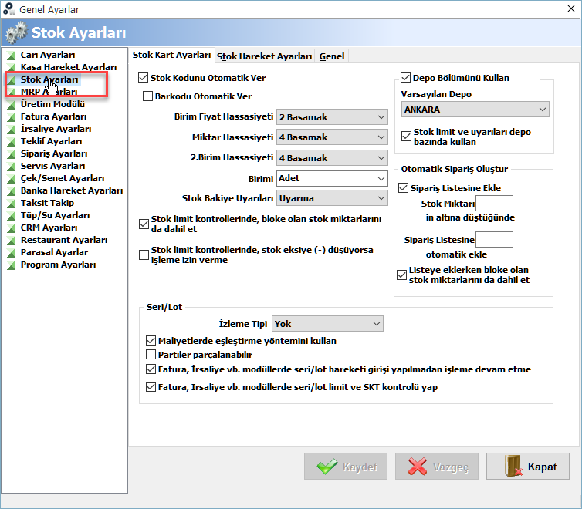
STOK BİRİM tANIMLARI

Slide 14
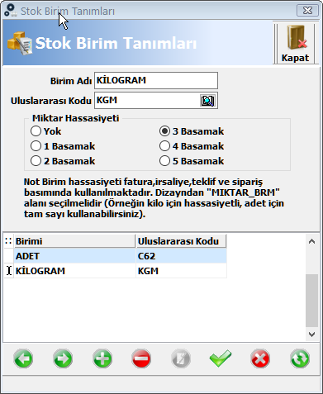
STOK BİRİM tANIMLARI

Slide 15
STOK BİRİM tANIMLARI

Slide 16
https://github.com/ademakkus/
https://www.linkedin.com/in/ademakkus/
https://www.instagram.com/akkusadem19/
https://www.facebook.com/akkusadem19

